Slide 1
CIRCUIT AND SYSTEMS
COURSE CODE: ETEE-207
By
Mr. LALIT AGARWAL
ASSISTANT PROFESSOR
EEE, MAIT

Slide 2
LECTURE-10&11

Slide 3
LAPLACE TRANSFORM OF SIGNALS & WAVEFORMS

Slide 4
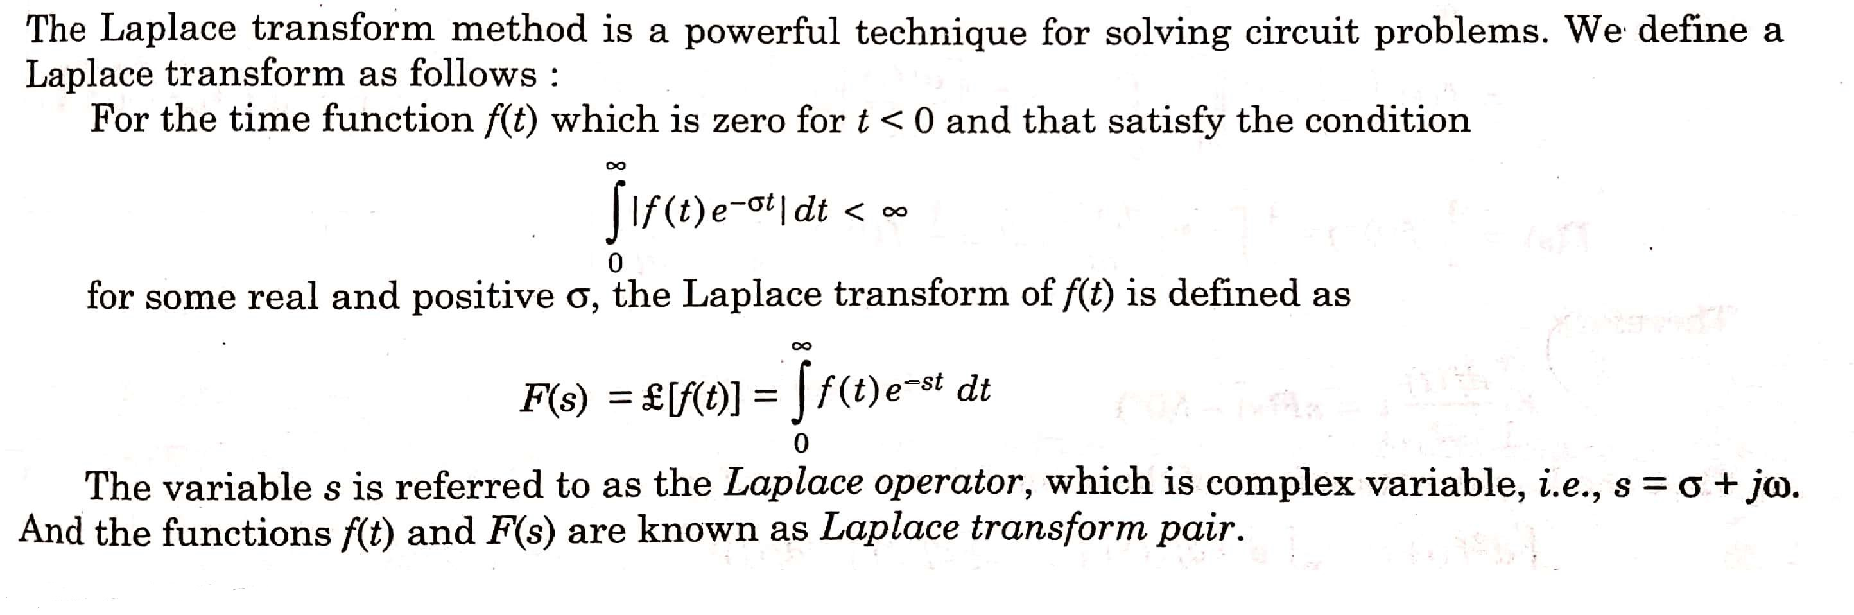
LAPLACE TRANSFORM

Slide 5
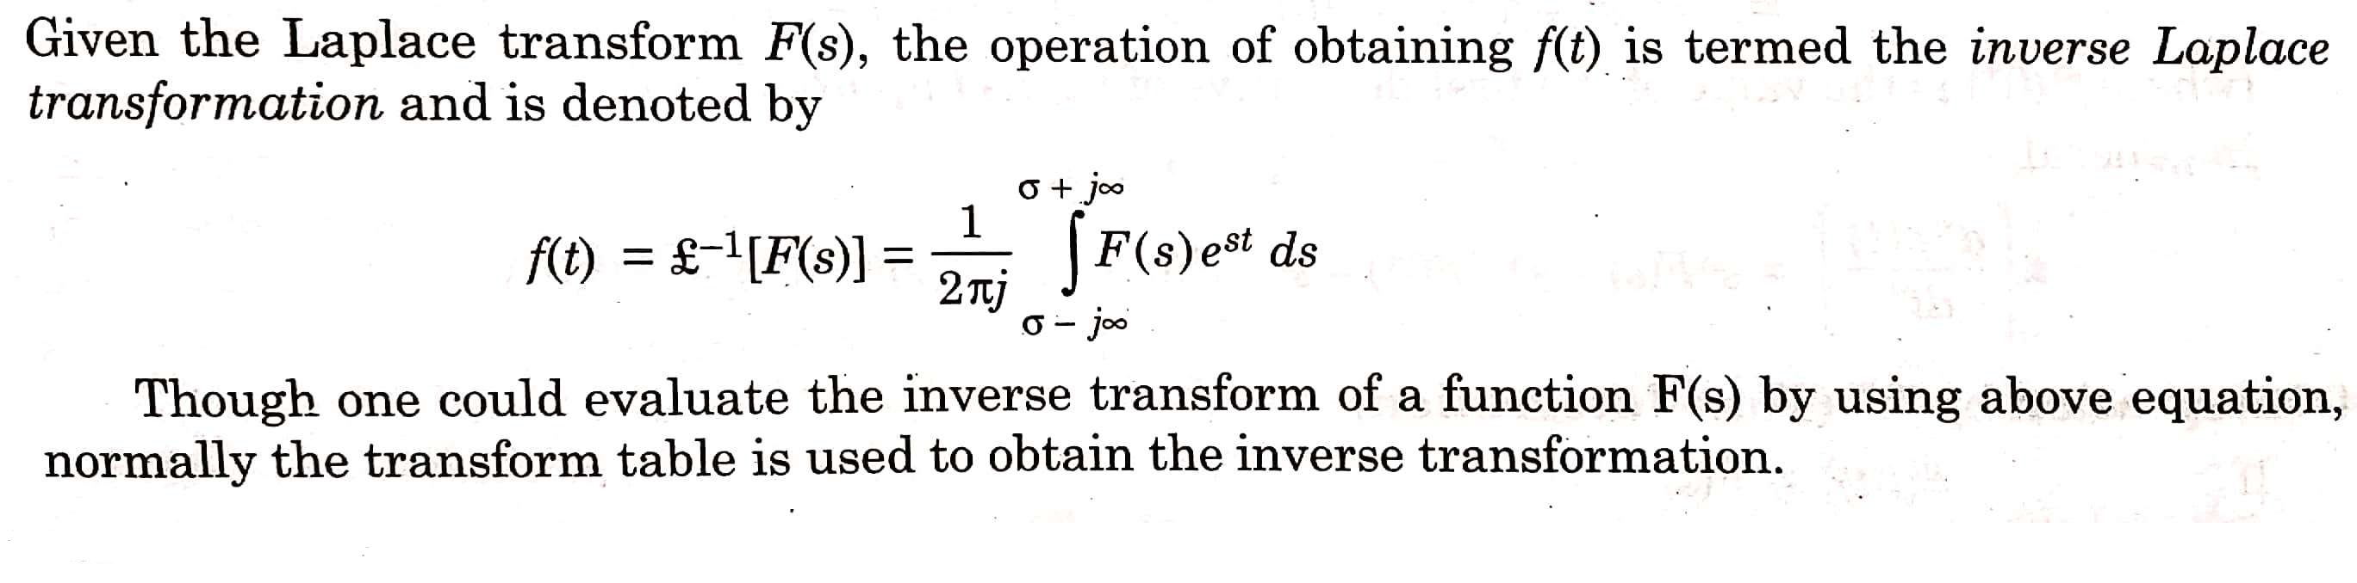
INVERSE LAPLACE TRANSFORM

Slide 6
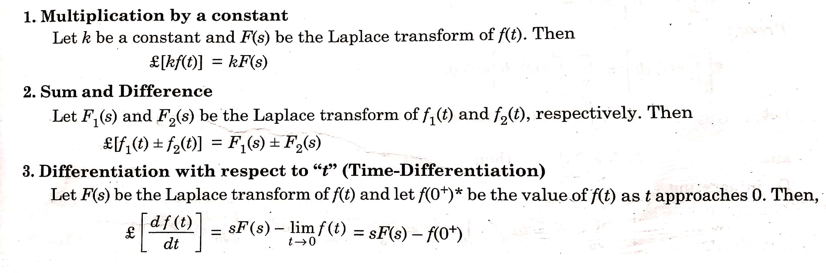
PROPERTIES OF LAPLACE TRANSFORM

Slide 7
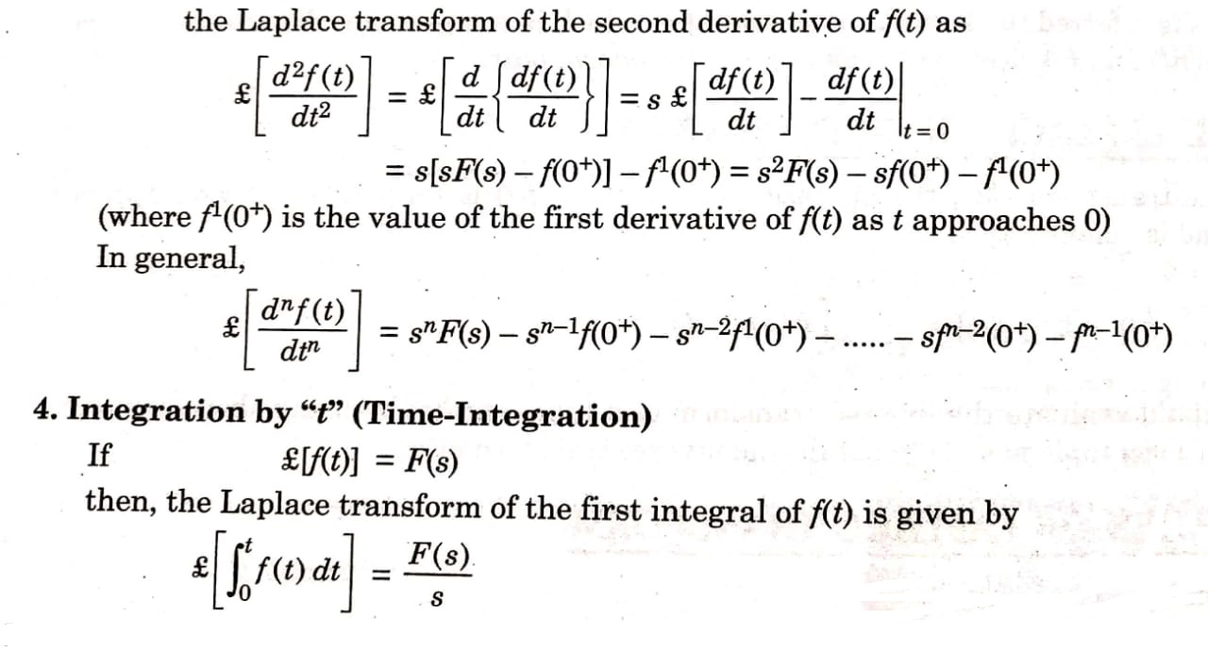

Slide 8
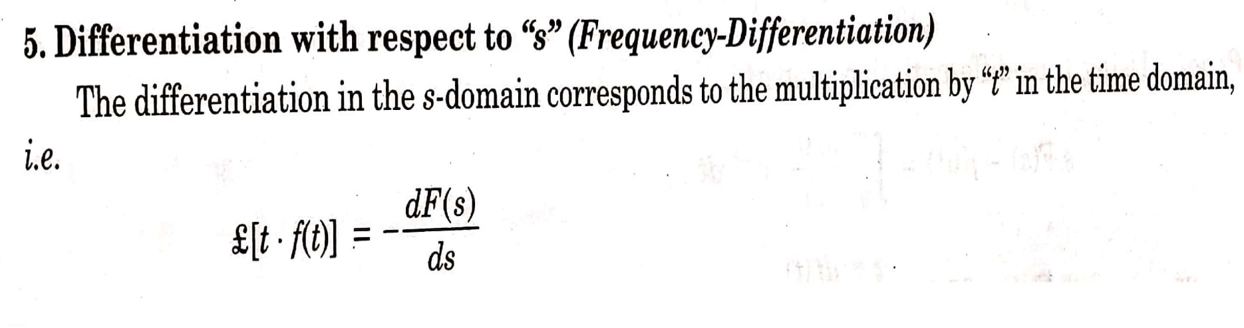
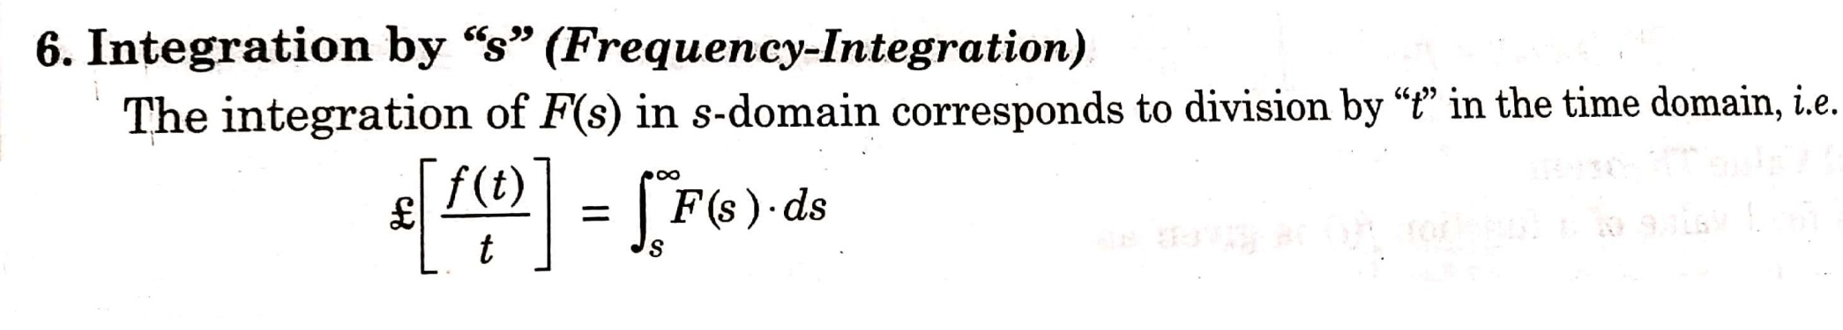

Slide 9
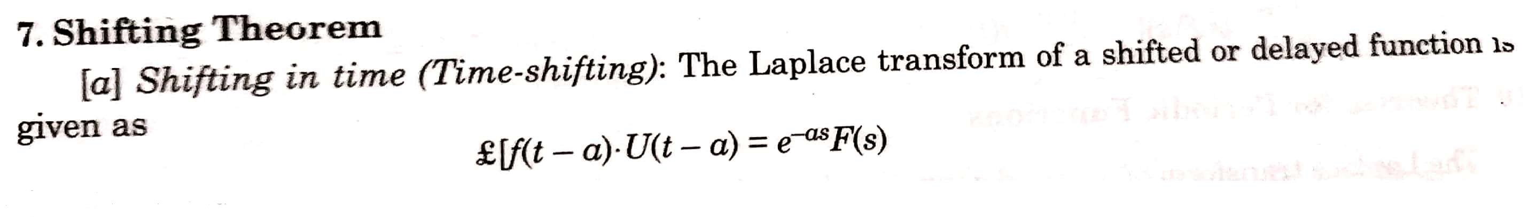

Slide 10
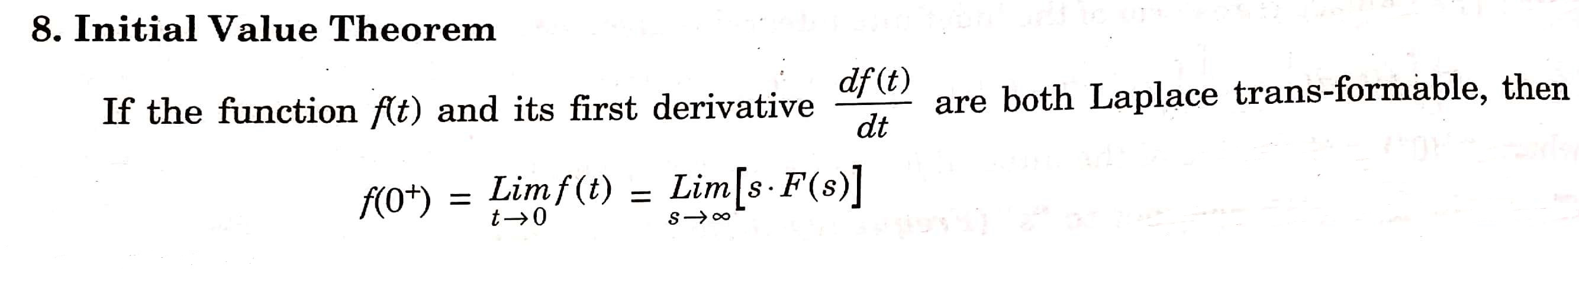
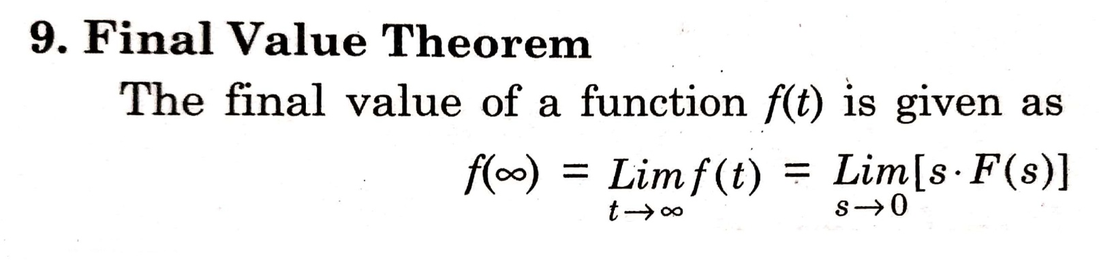

Slide 11
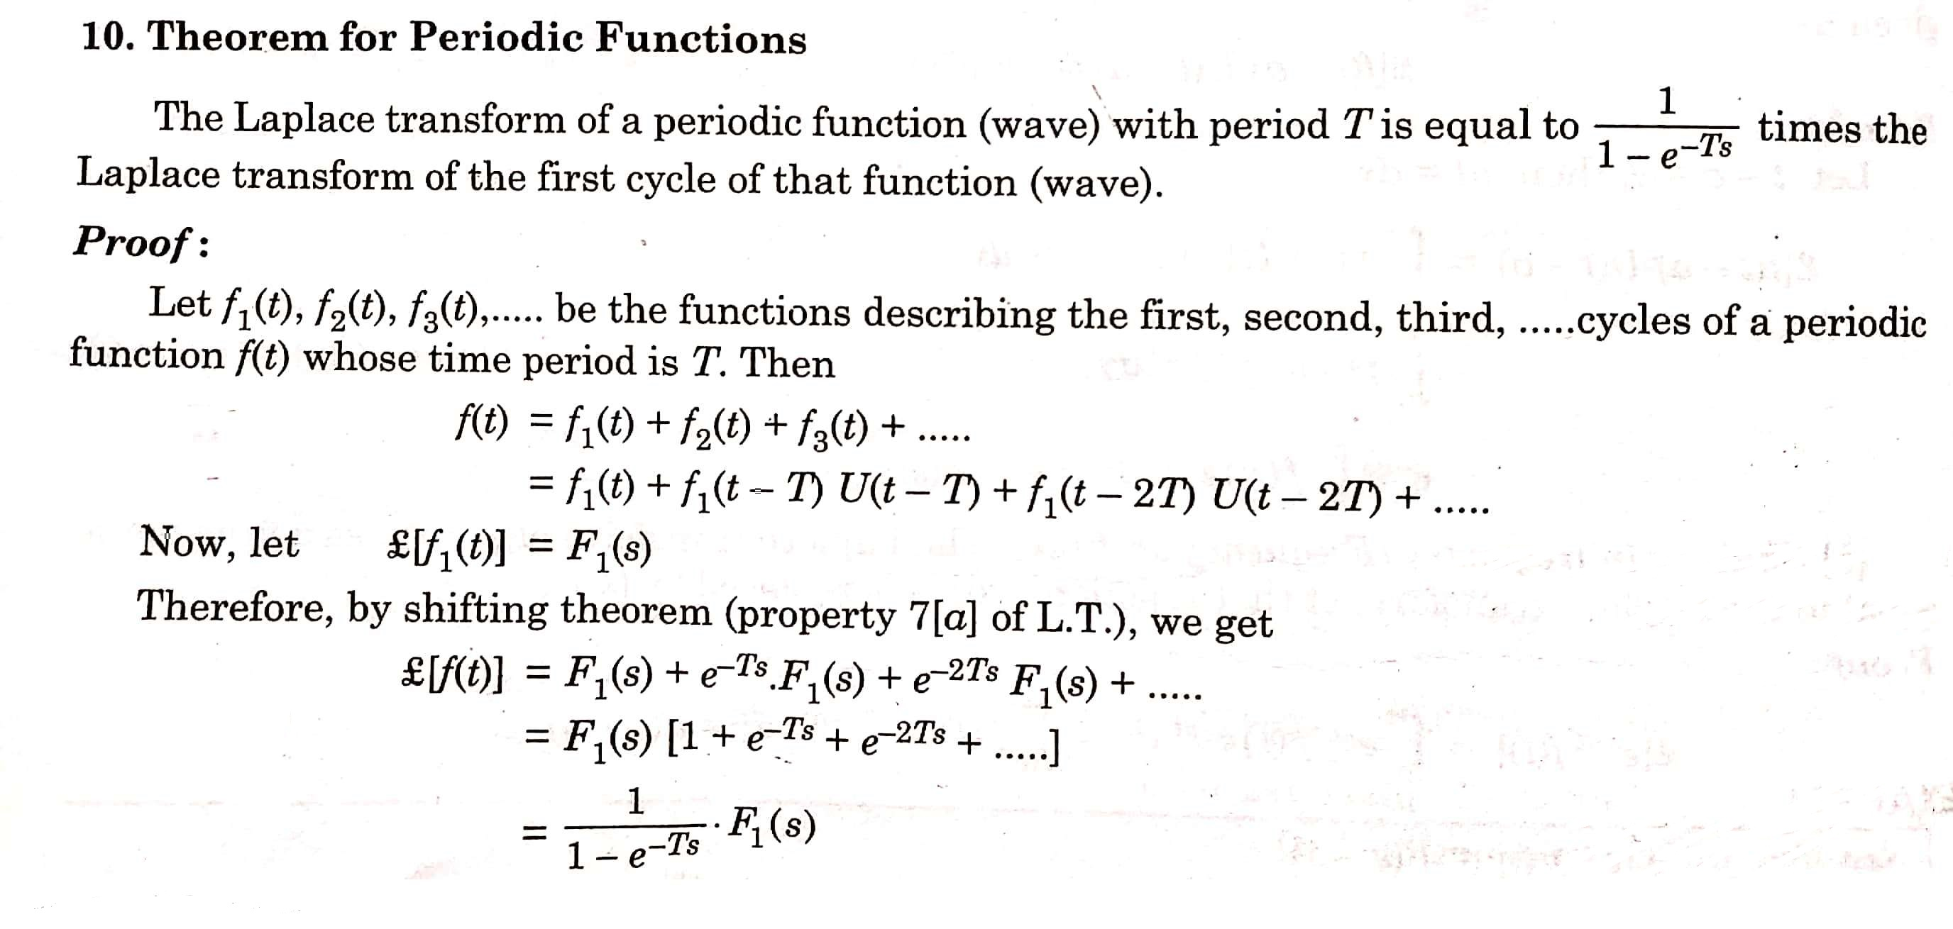

Slide 12
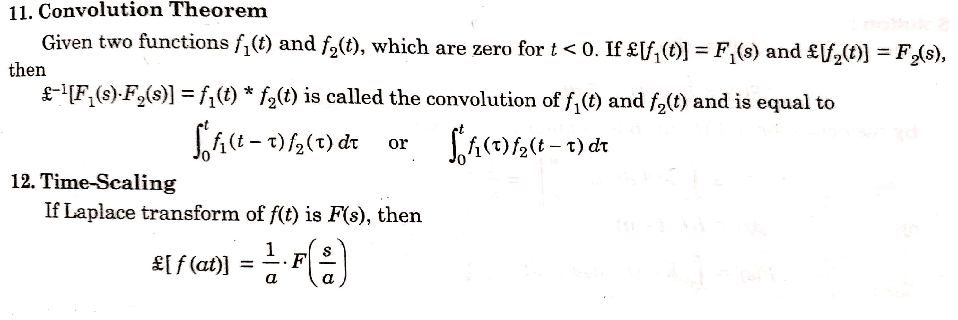

Slide 13
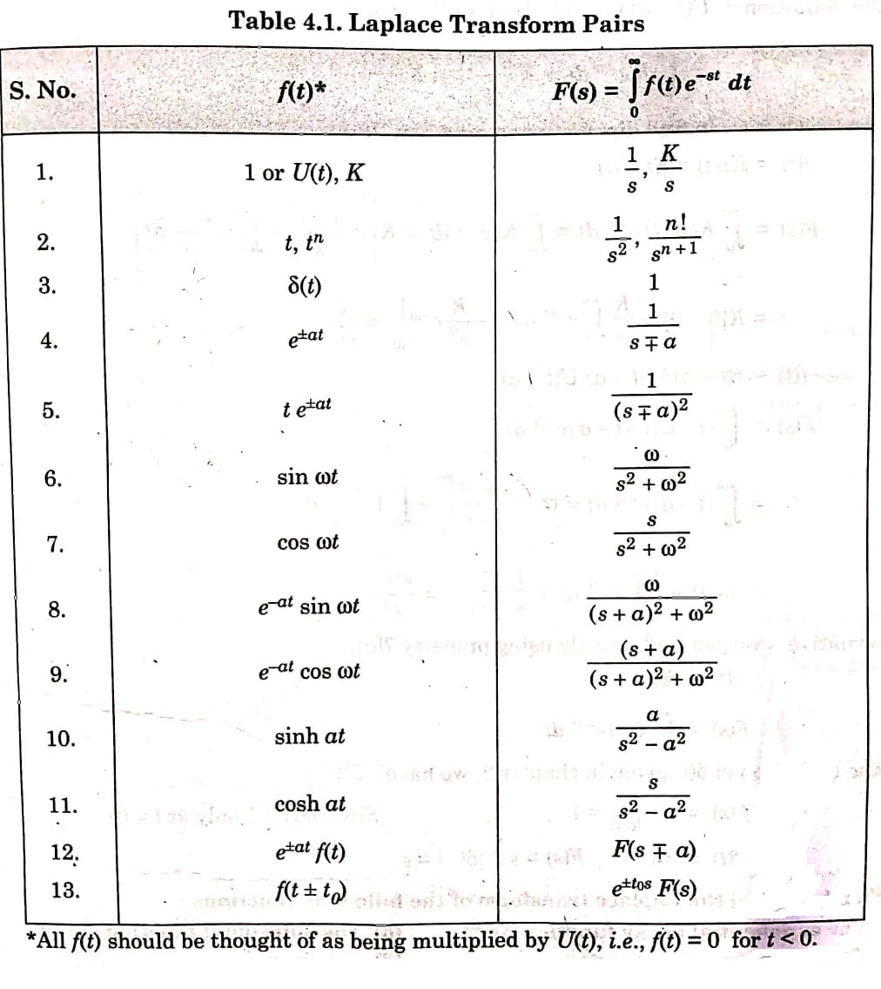

Slide 14
NUMERICALS

Slide 15
Q 1) Find the Laplace transform of the following standard signals(functions)
(a) Unit step function U(t)
(b) Delayed step function KU(t-a)
(c) Ramp function Kr(t) or Kt U(t)
(d) Delayed unit ramp function r(t-a)
(e) Unit impulse function ẟ(t)

Slide 16
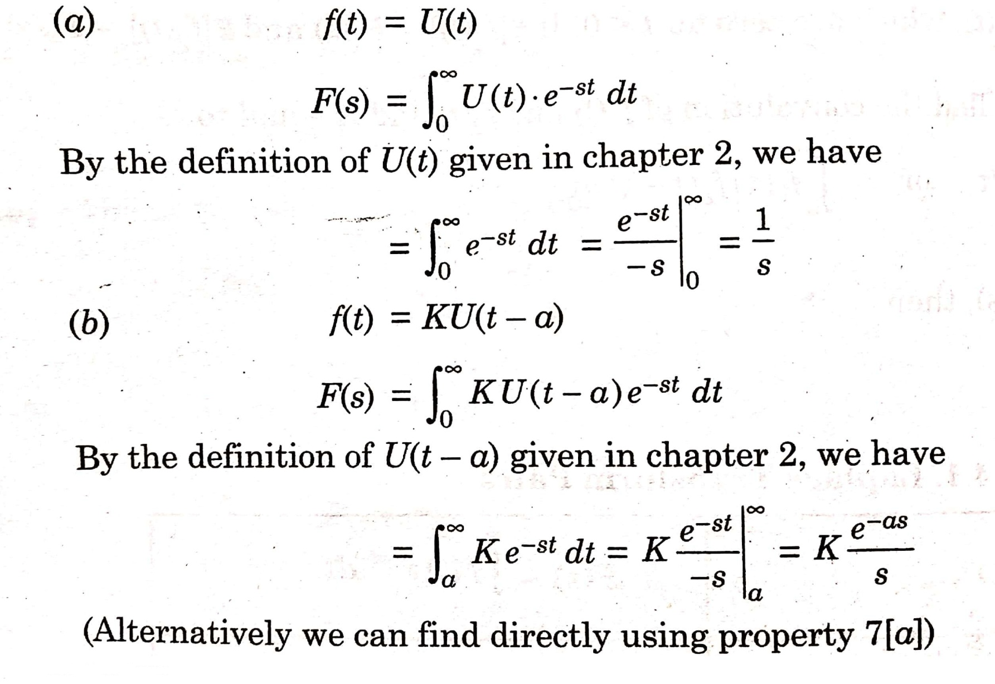
SOLUTION (1)

Slide 17
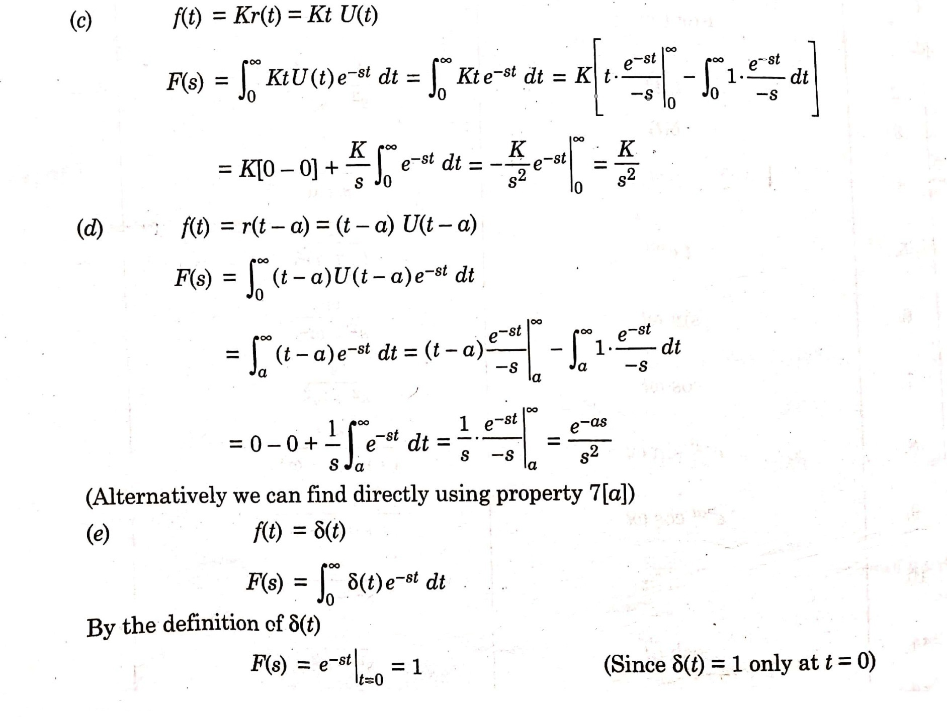

Slide 18
Q 2) Find the Laplace transform of the following functions:
K e^{-at}
e^{-2t} Sinωt
e^{5t} Cosωt
e^{3t} t U(t)
e^{-5t} t³

Slide 19
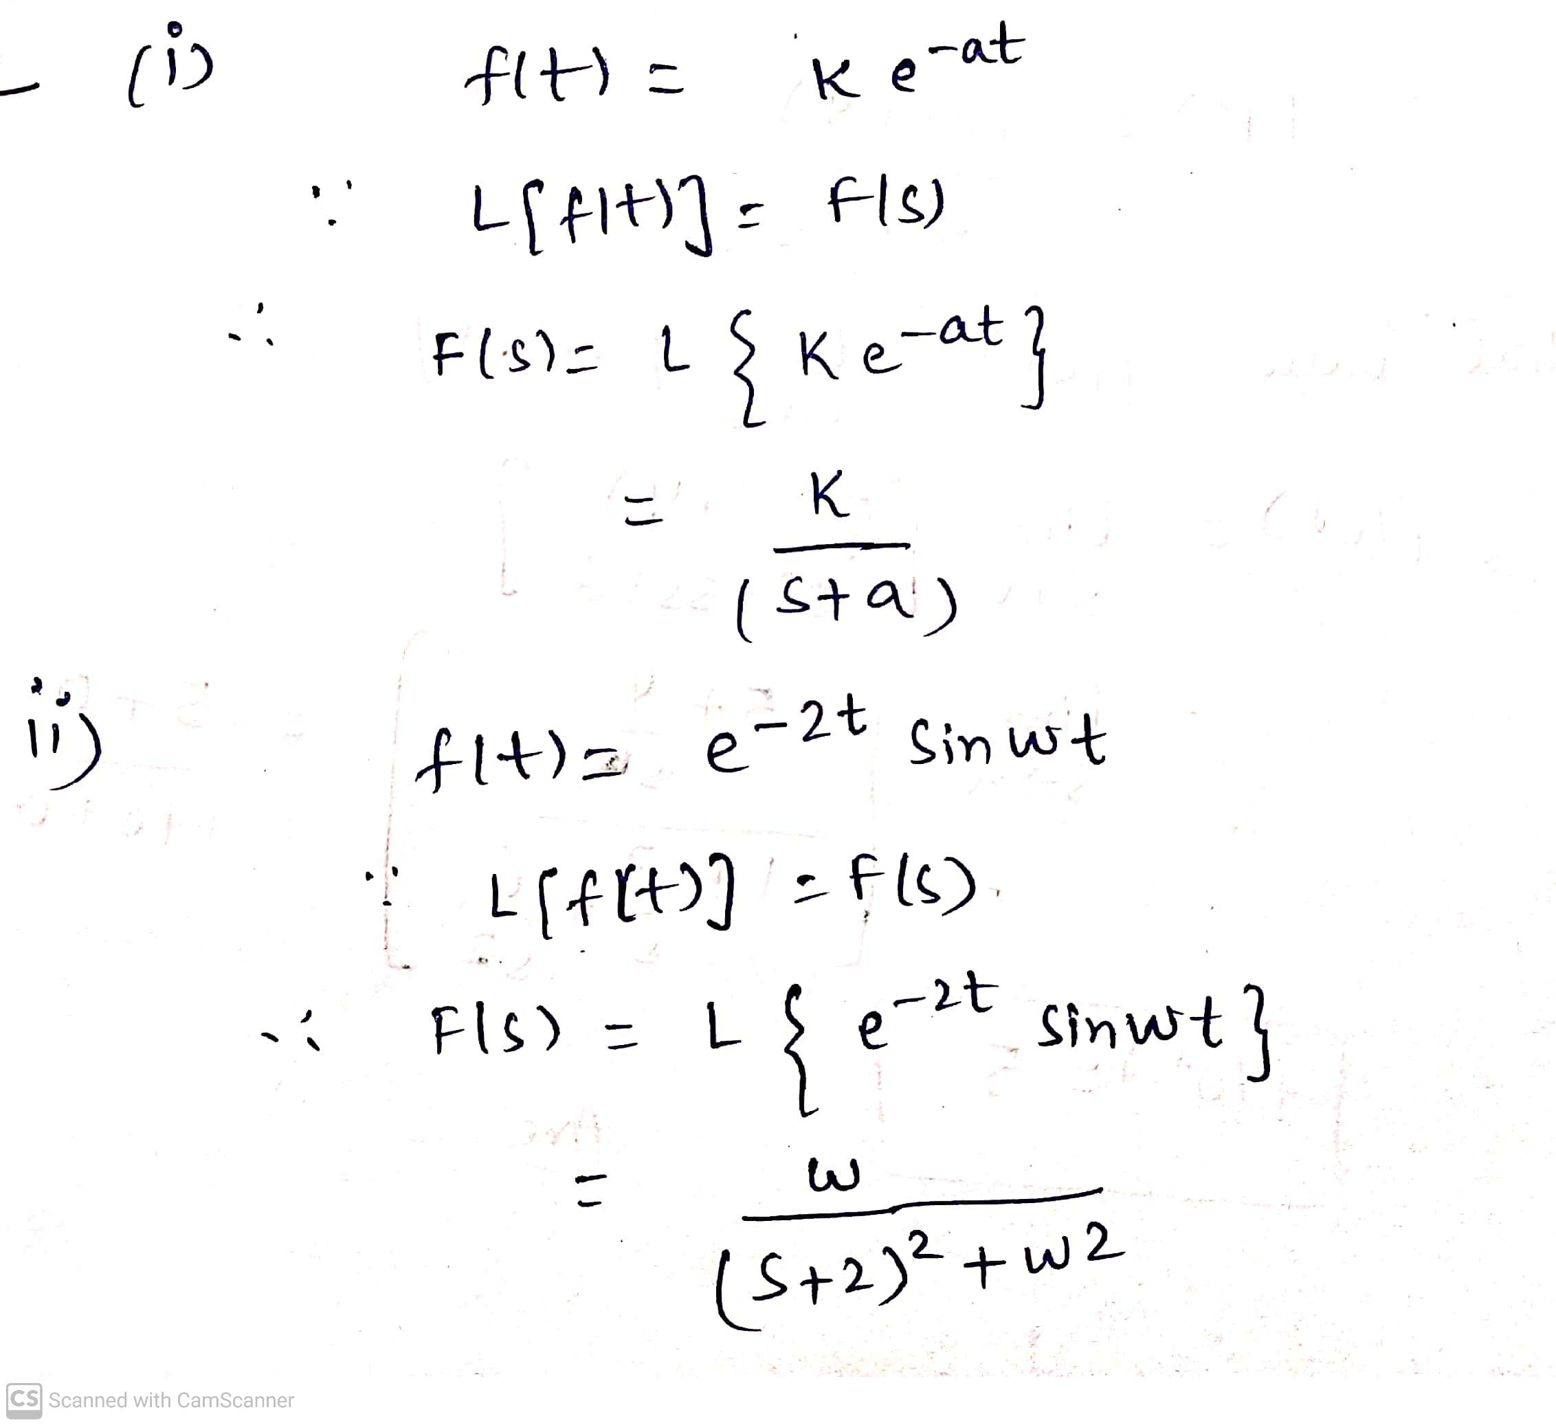
SOLUTION 2

Slide 20
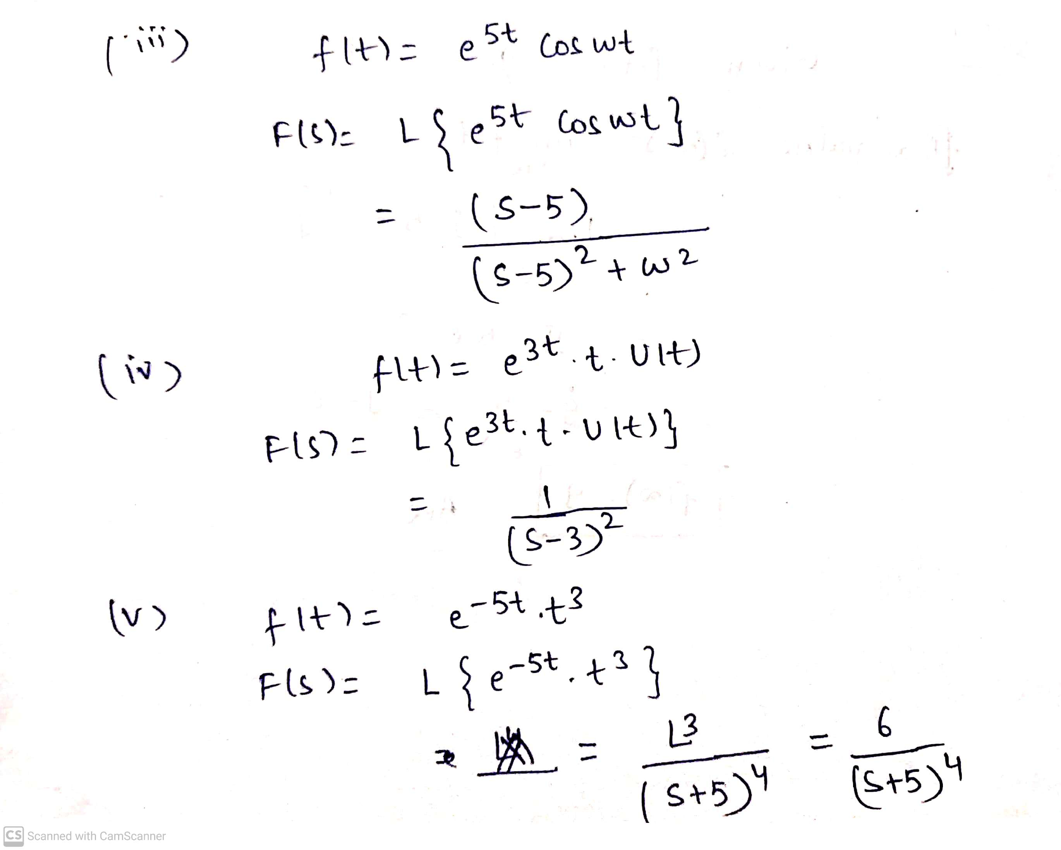

Slide 21
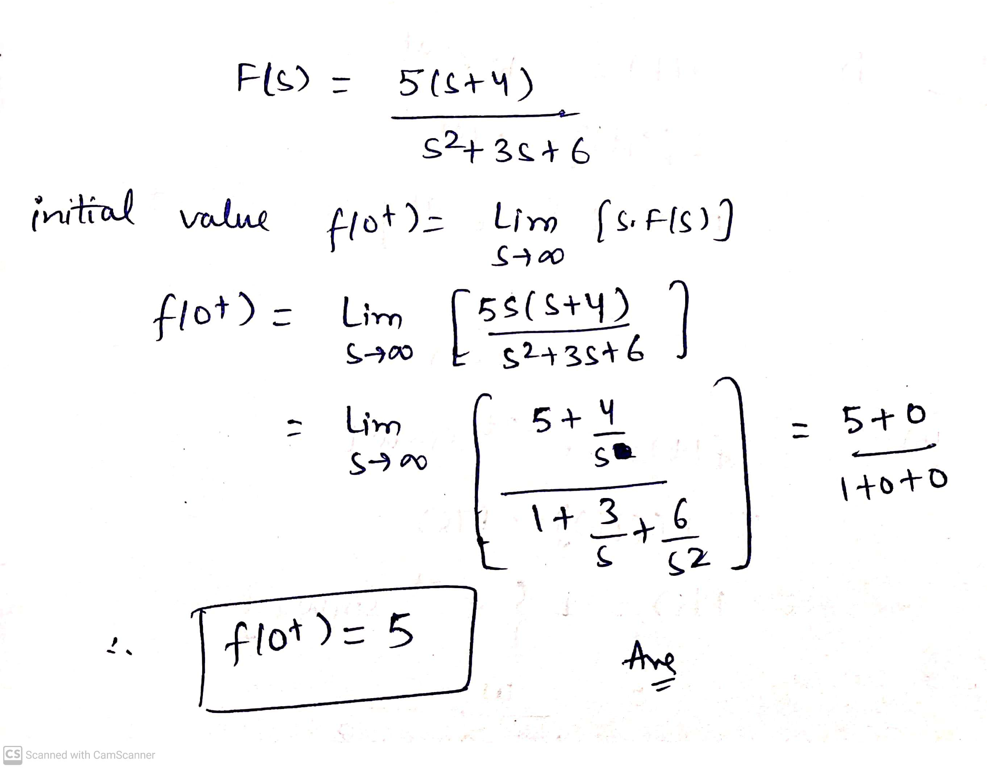
Q 3) Determine the initial value f(0⁺) , if
F(s) = 5( s + 4) / (s² + 3s + 6)
SOLUTION(3) :

Slide 22
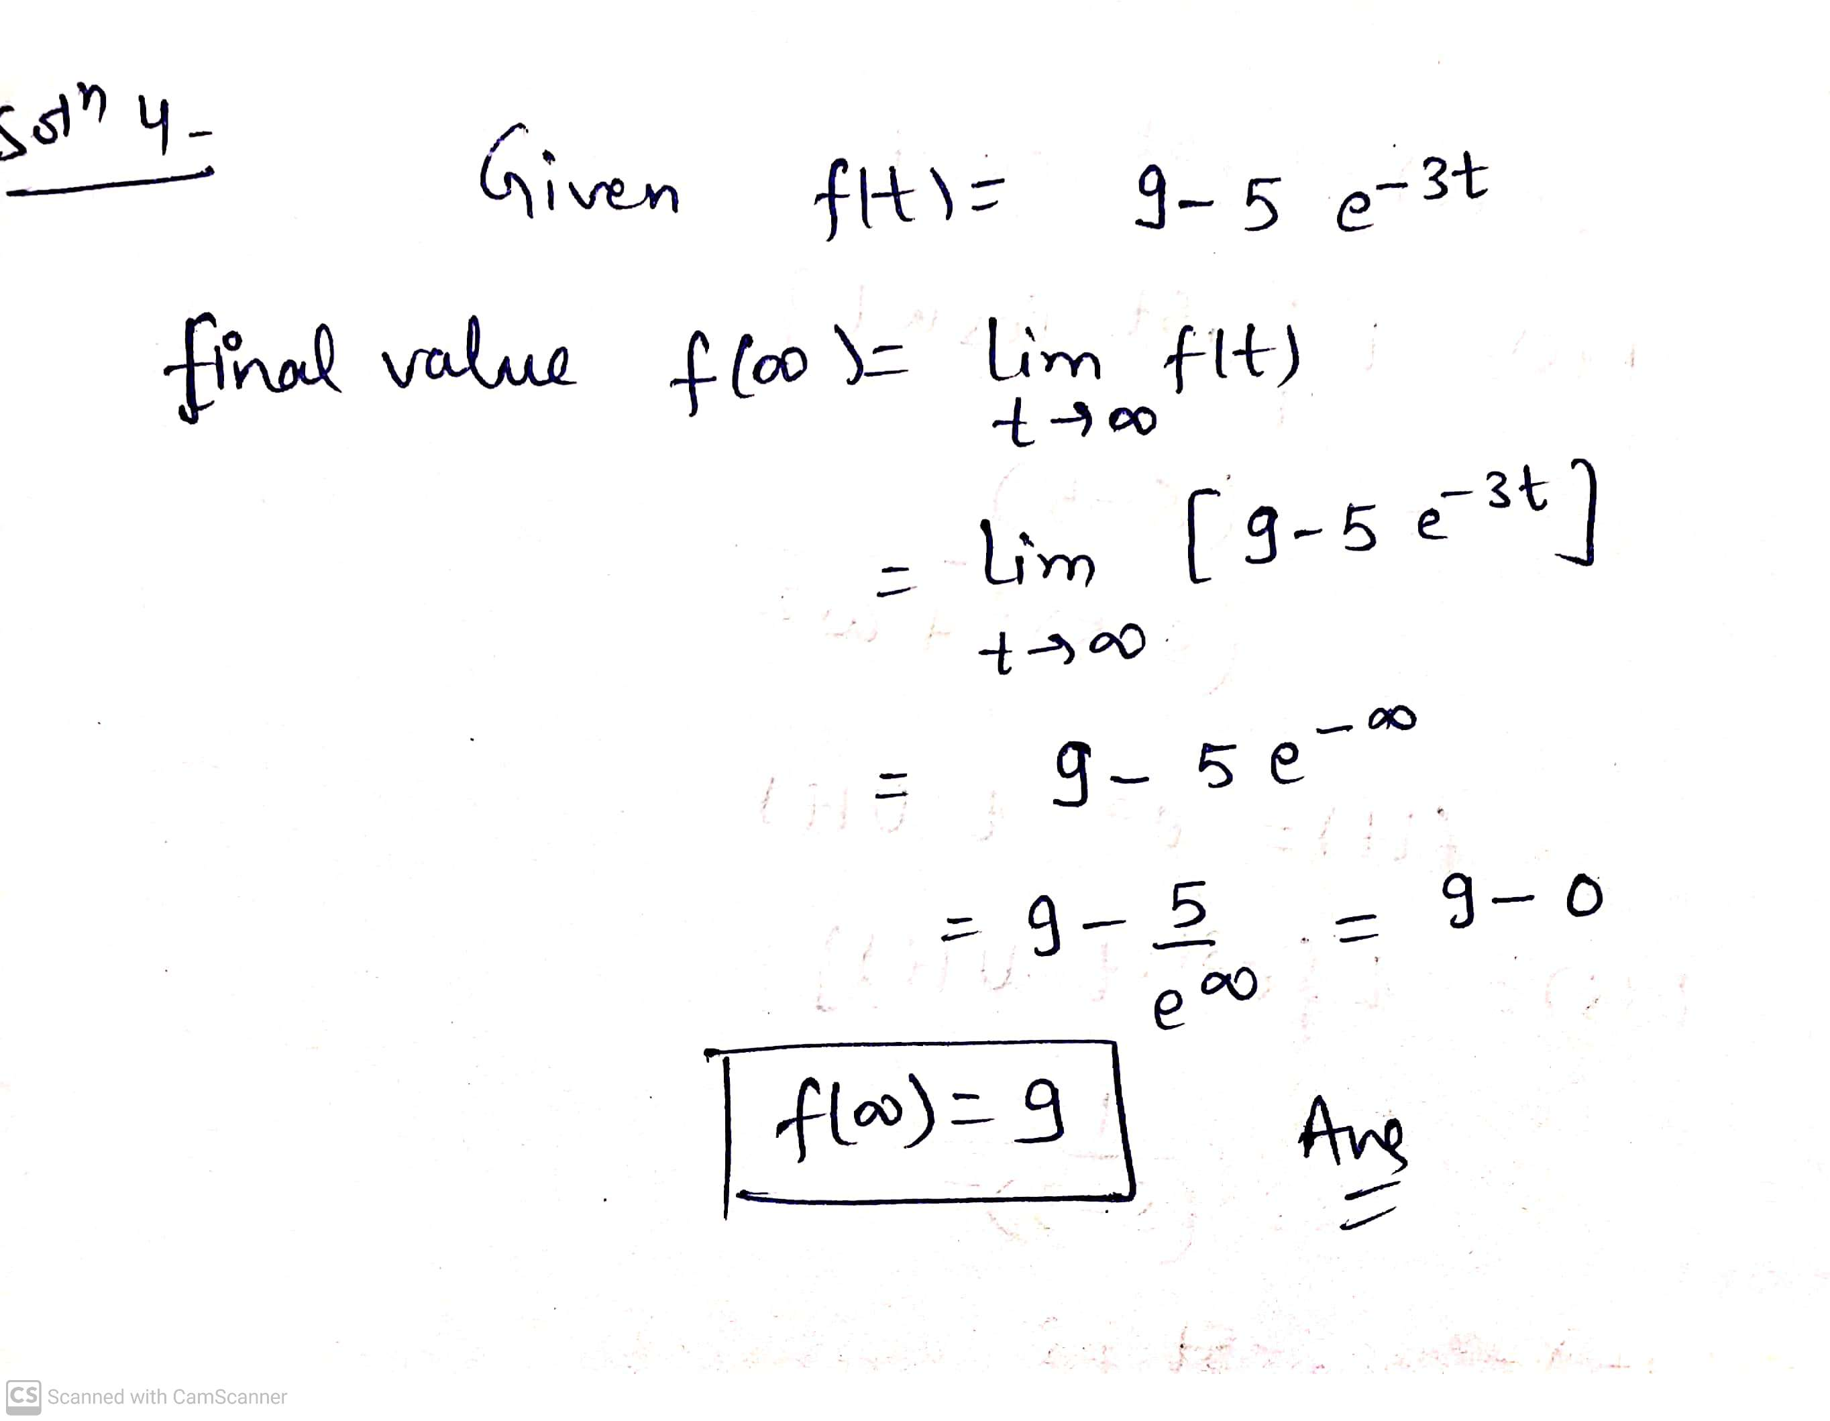
Q 4) Find the final value of the function,
f(t) = 9- 5 e^{-3t}
SOLUTION(4) :

Slide 23
Q 5) Given the function,
F(s) = (5s + 3)/ s(s+1)
Find the initial value f(0⁺), final value f(∞), and the corresponding time function f(t).
SOLUTION (5) :

Slide 24
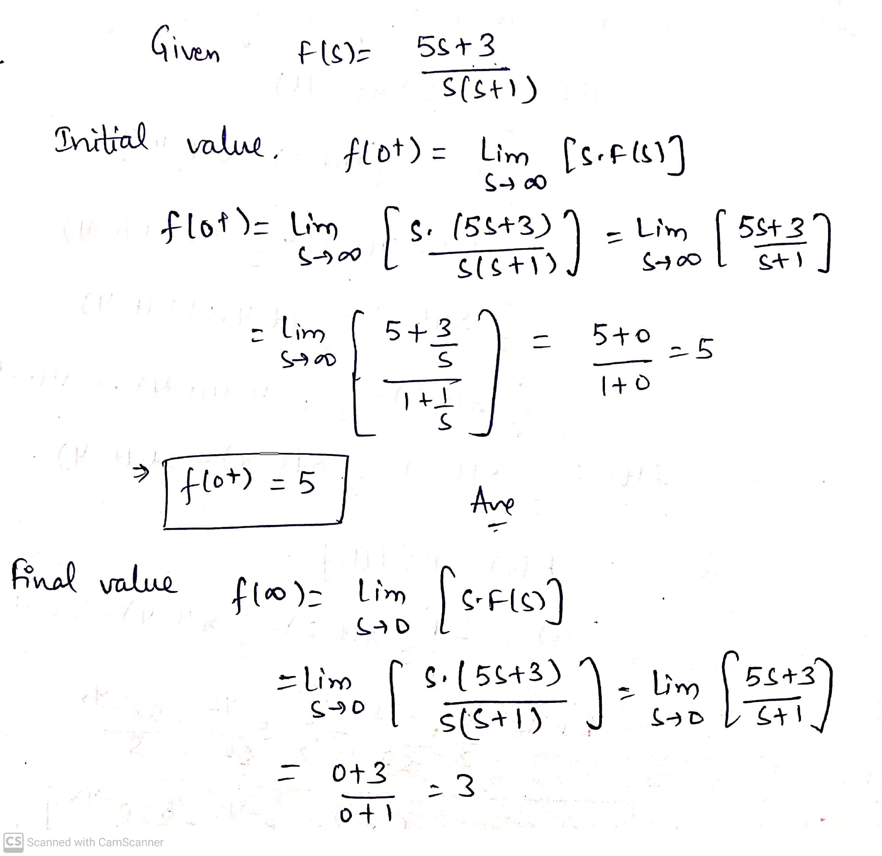

Slide 25
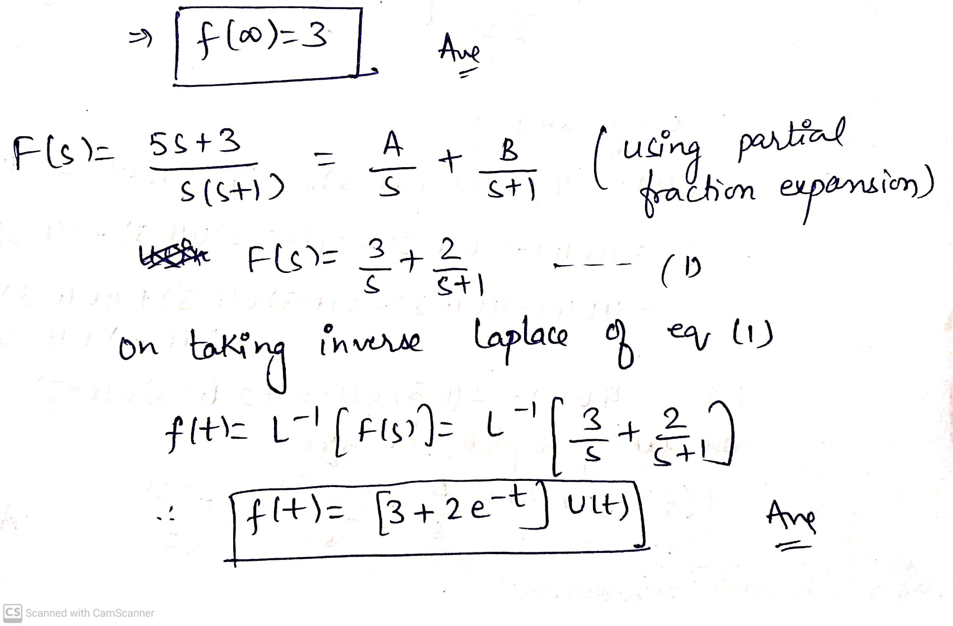

Slide 26
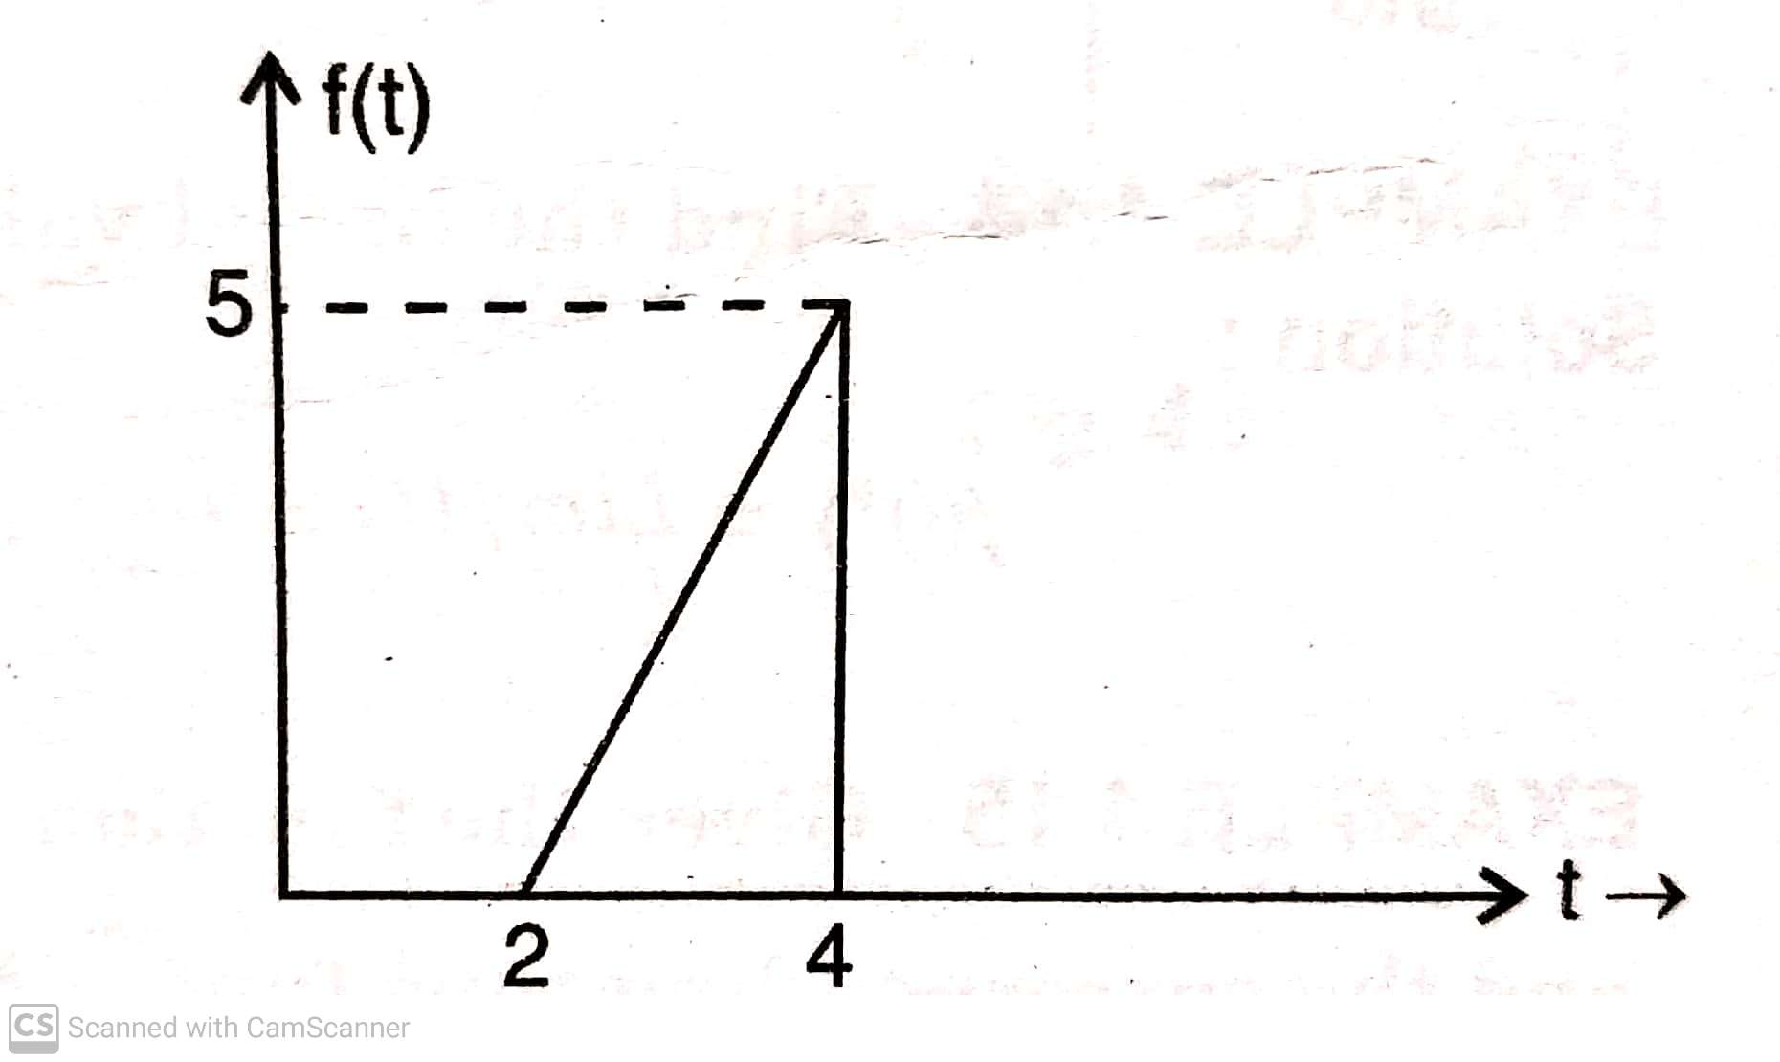
Q 6) Find the Laplace transform of the time function shown in figure below.

Slide 27
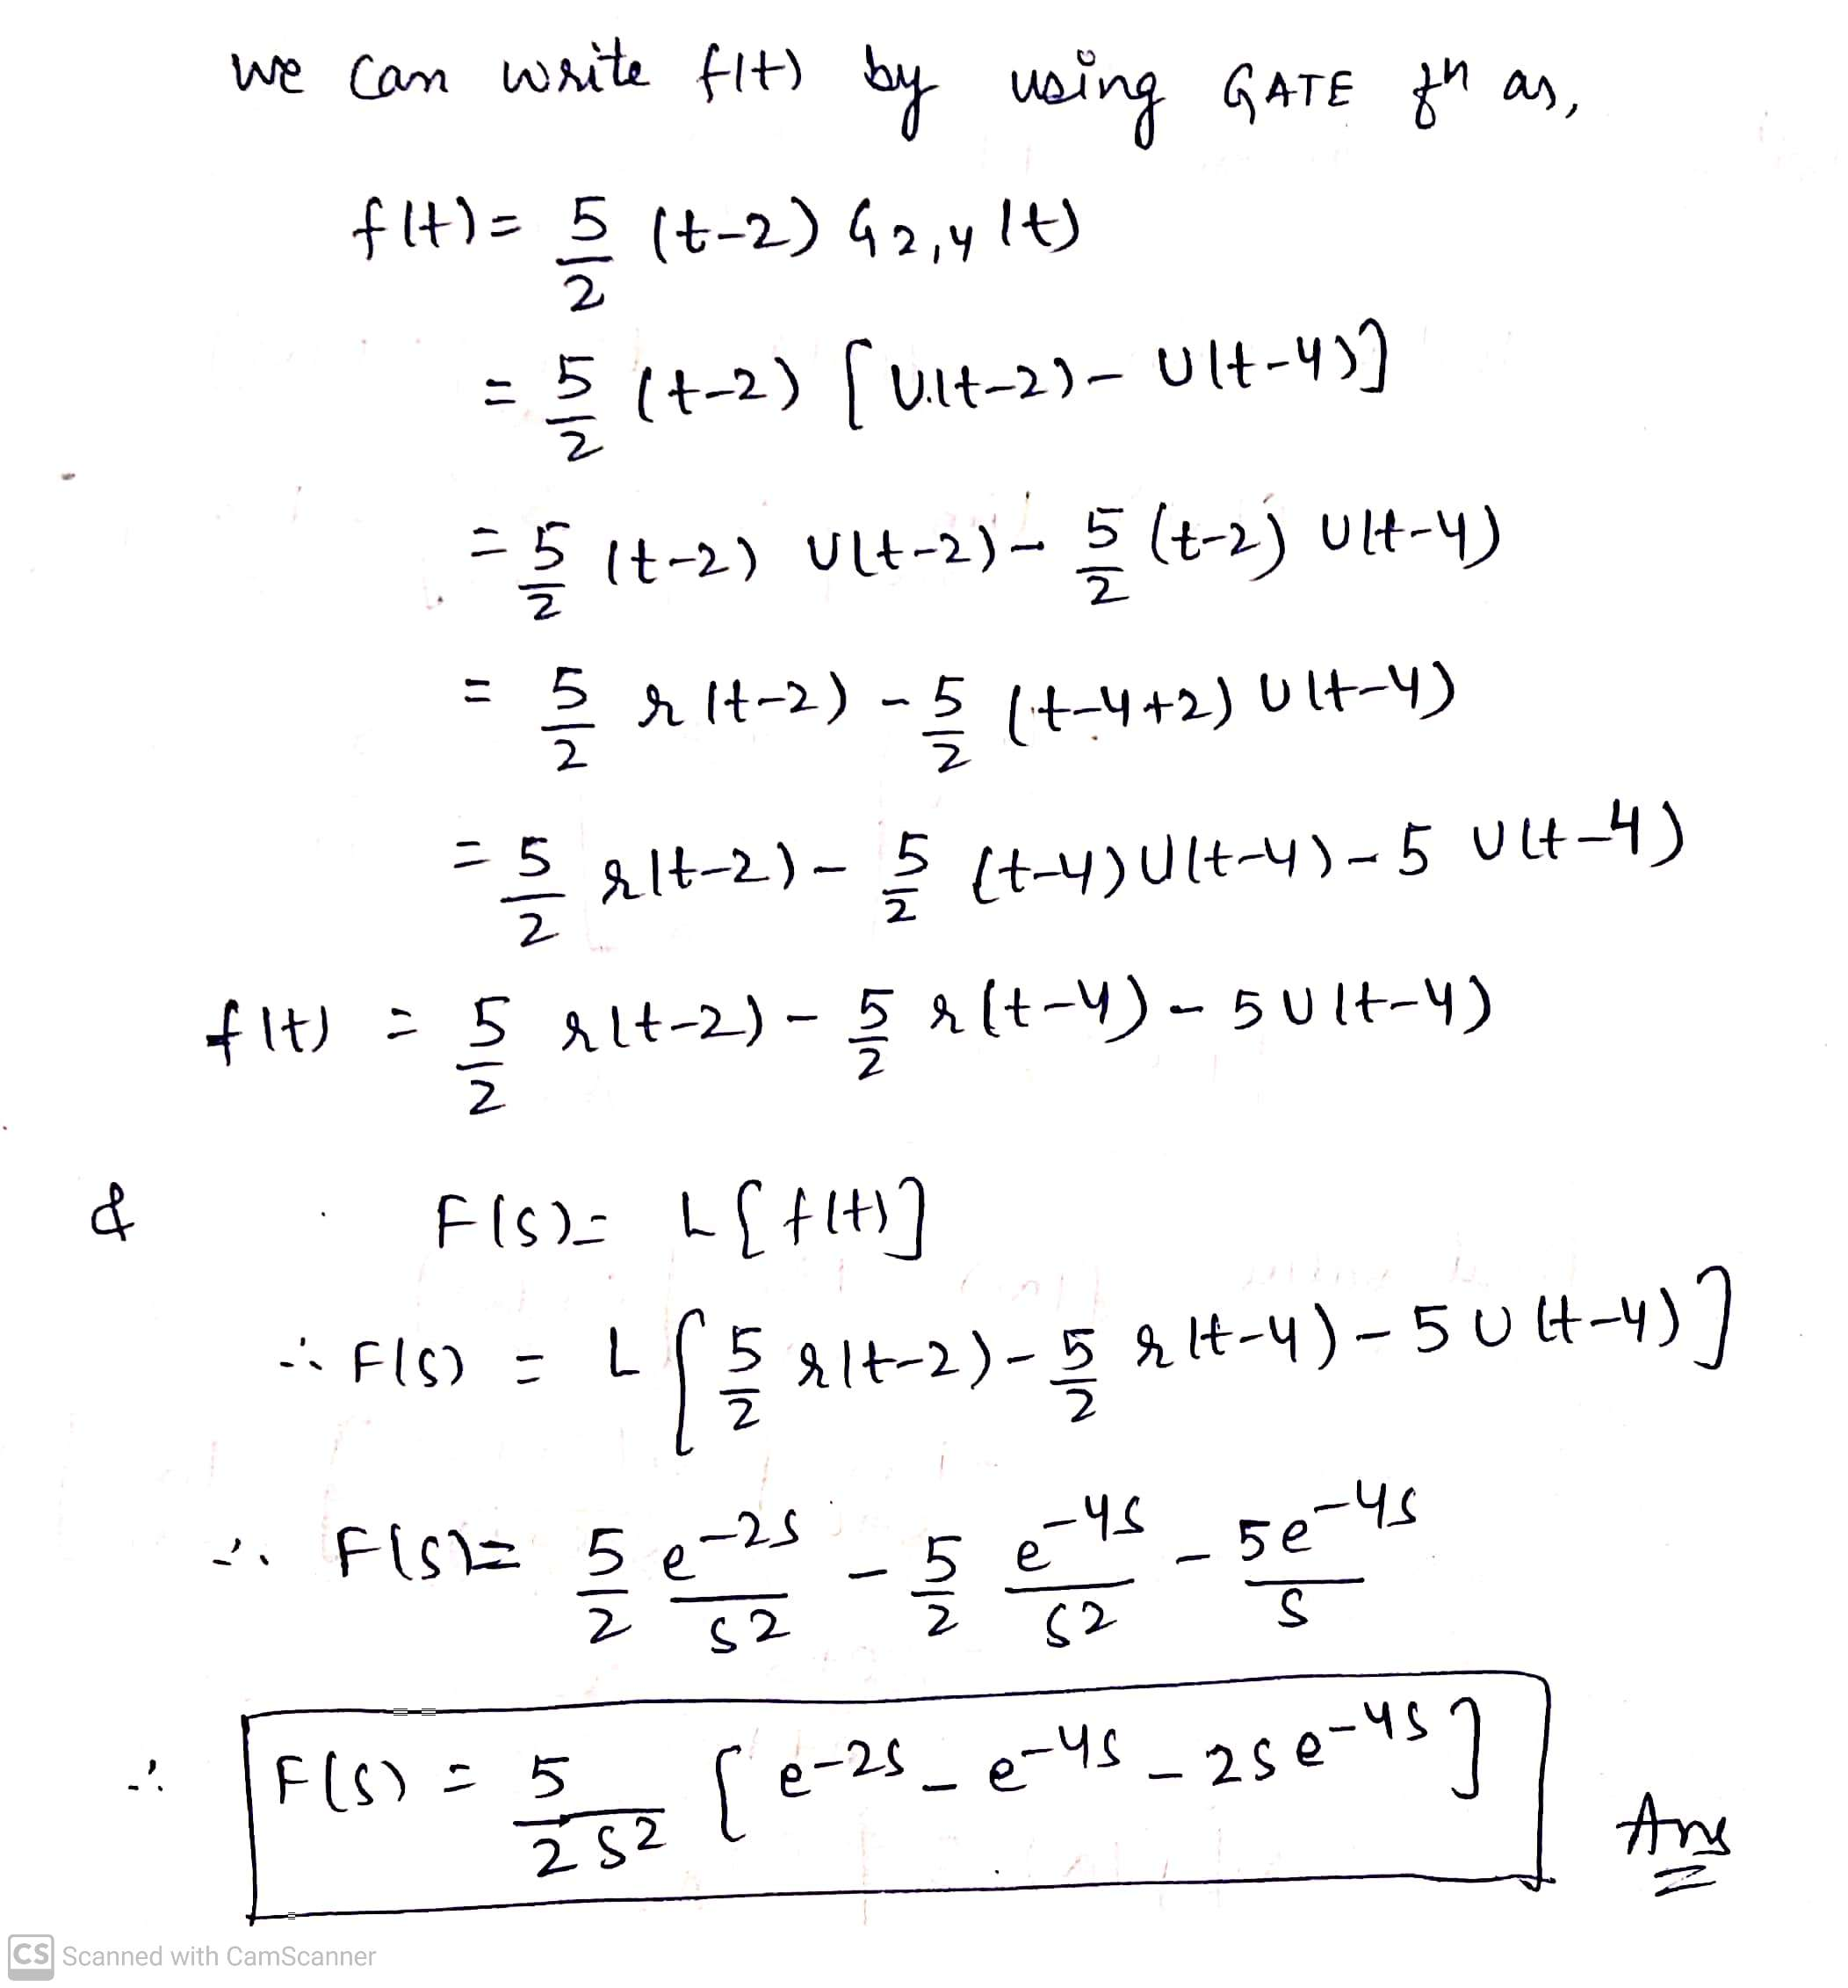
SOLUTION(6)

Slide 28
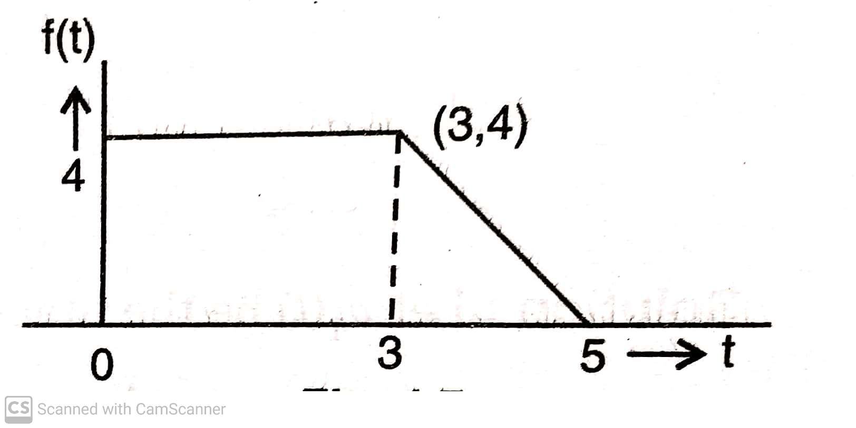
Q 7) Determine the Laplace transform of the waveform shown in figure below:

Slide 29
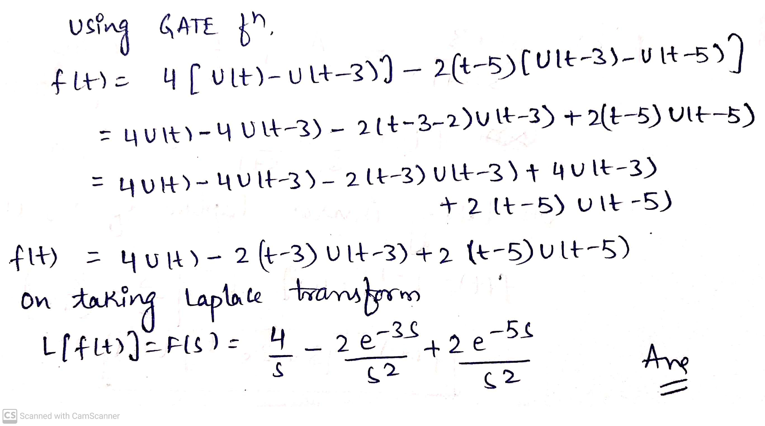
SOLUTION(7)

Slide 30
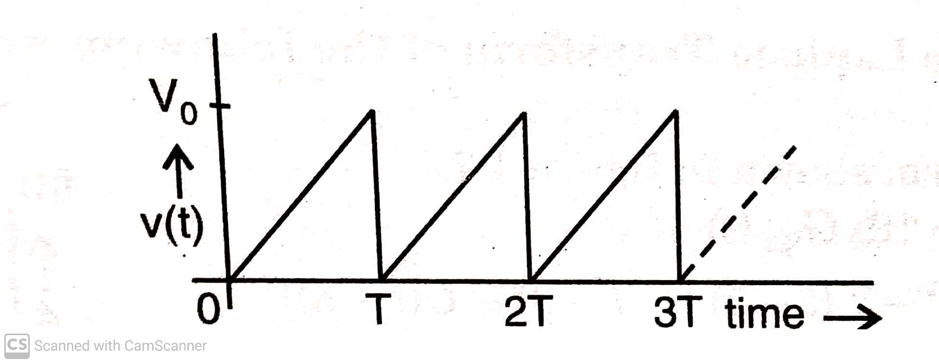
Q 8) Find the Laplace transform of the waveform shown in figure below:

Slide 31
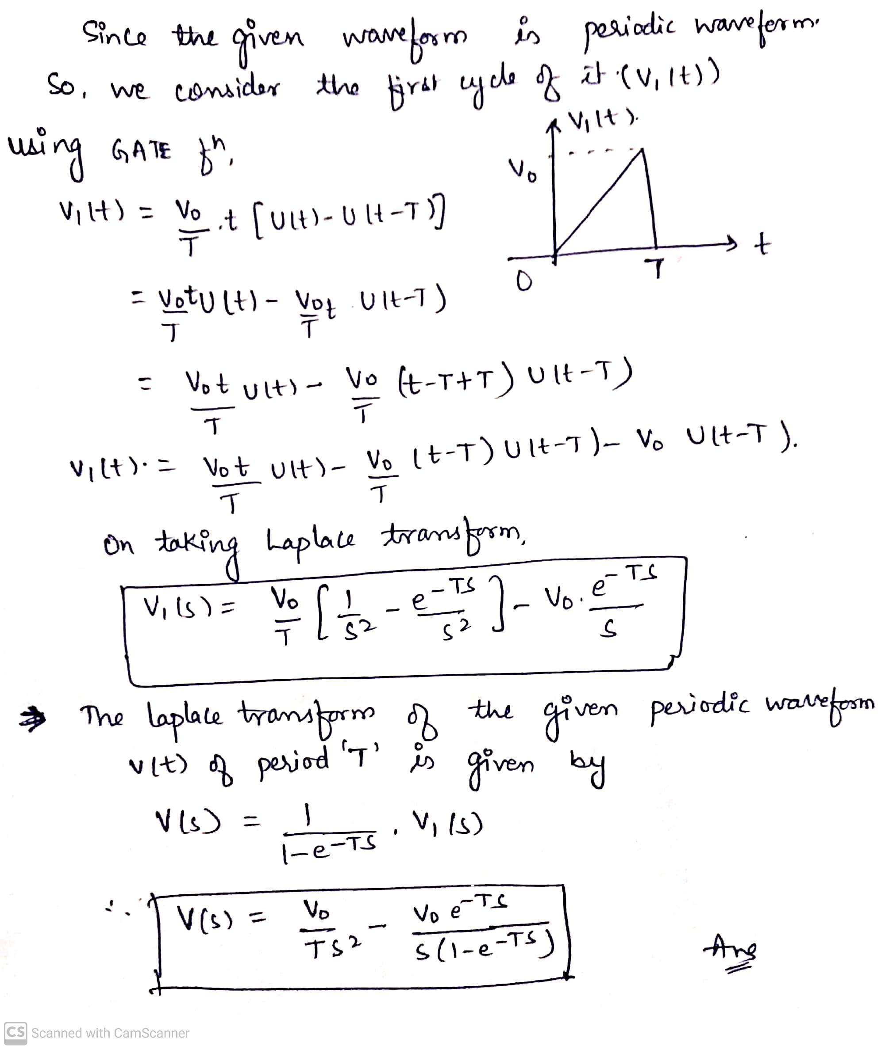
SOLUTION (8)

Slide 32
QUESTIONS FOR PARCTICE
Q 1) Find the initial and final values , if they exist, of the signals with Laplace transforms given below:
F(s) = ( S+10)/ (S²+3S+2)
F(s) = (S²+5S+7)/(S²+3S+2)
Q 2) Find the initial values of the signals given below:
f(t) = e^{-at} Cosωt U(t)
f(t) = e^{-at} Sinωt U(t)
f(t) = [e^{-2t} + e^{-t} Cos3t ] U(t)
f(t) = (1+2t+5t³) / (1+6t)

Slide 33
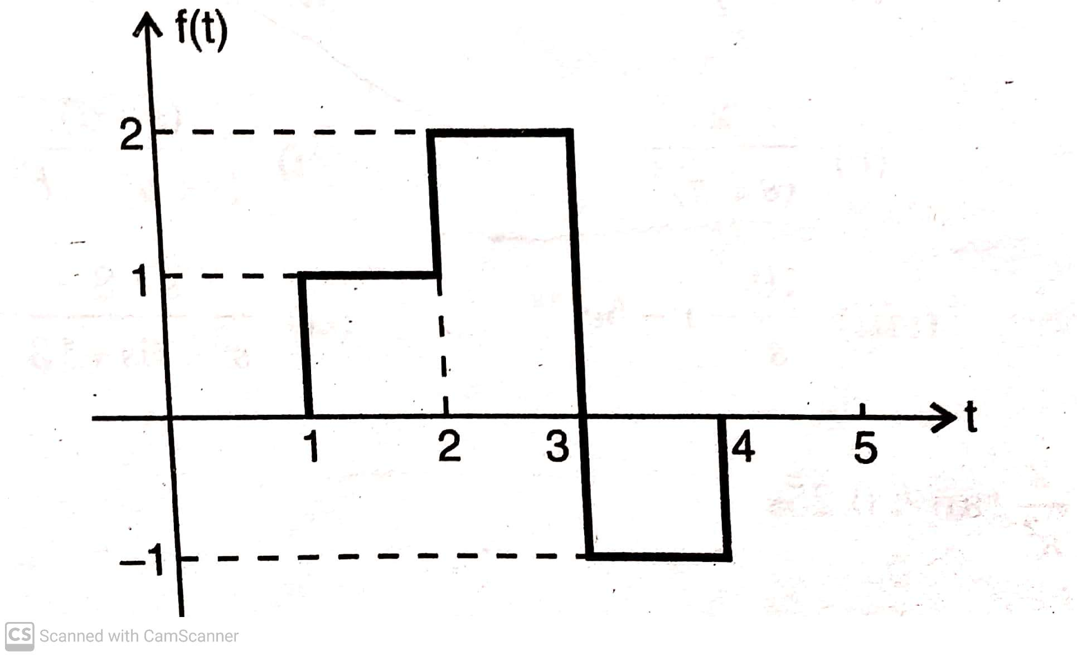
Q3) Find the final value of the signals with the Laplace transforms given below:
F(s) = 5/s(s²+s+2)
F(s) = 7/ s(s+3)²
F(s) = (2/3) – 1/(s+3)
Q4) Find the Laplace transform of the waveform shown in figure below:

Slide 34
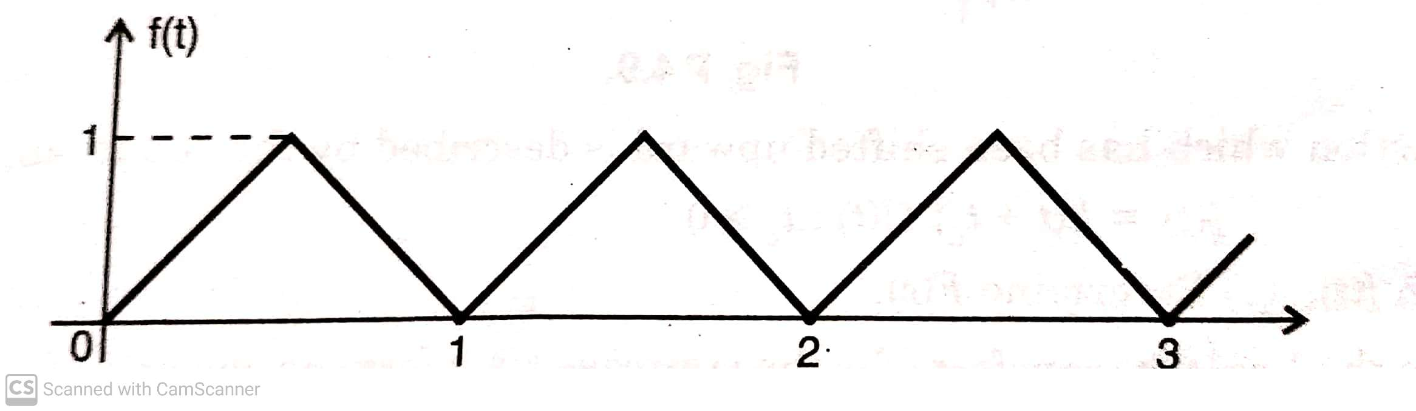
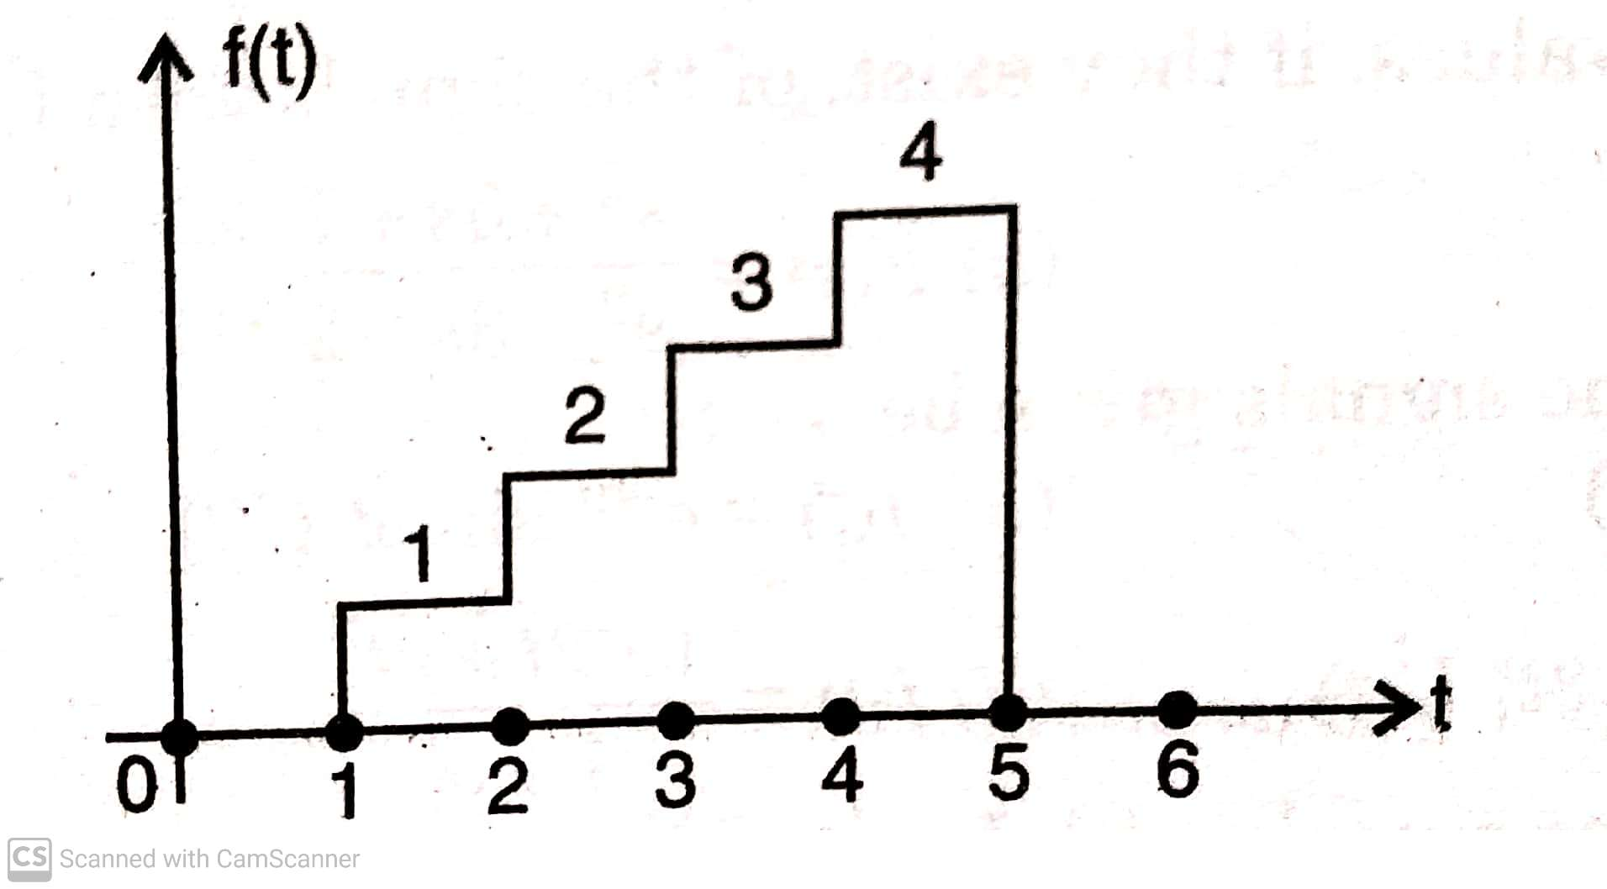
Q5) Find the Laplace transform of the function shown in figure below:
Q6) Find the Laplace transform of the staircase waveform shown in figure below:

Slide 35
ANSWERS
1) (a) 1,0 (b) ∞, 0
2) (a) 1 , (b) 0 , (c) 2 , (d) 1
3) (a) 5/2 , (b) 7/9 , (c) 0
4) F(s) = (e^{-s} + e^{-2s} - 3e^{-3s} + e^{-4s} ) /s
5) F(s) = 2(1- e^{-0.5s} ) / s²(1+ e^{-0.5s} ) = 2 tan h 0.25s / s²
6) F(s) = [e^{-s} + e^{-2s} + e^{-3s} + e^{-4s} - 4 e^{-5s}] / s

